Slide 1
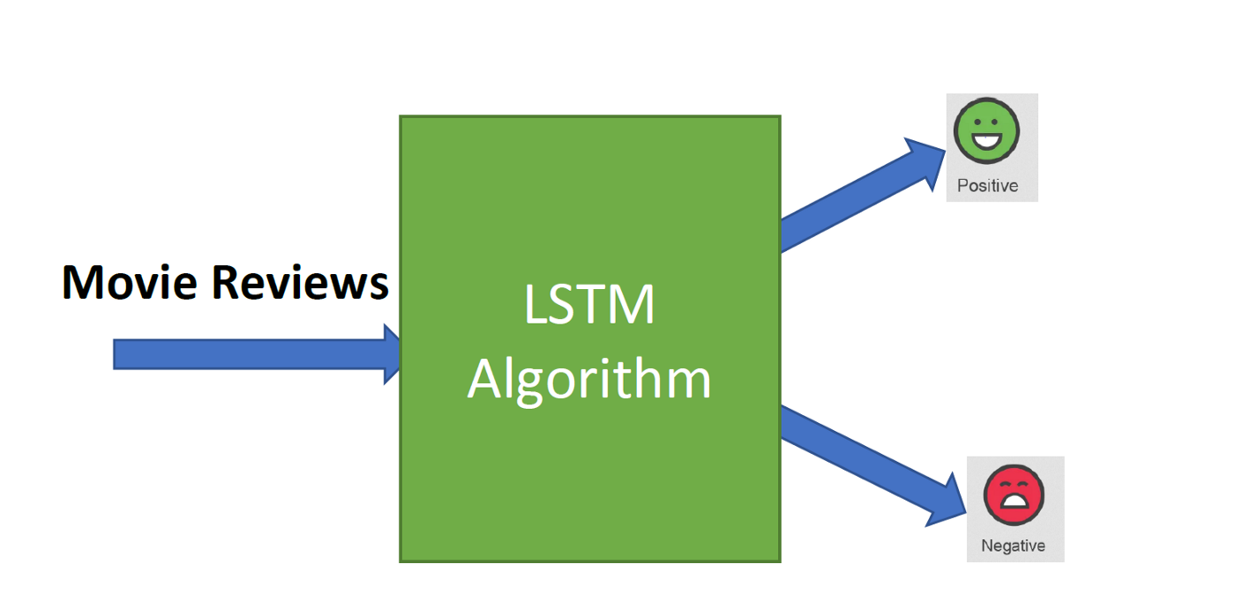
CSE 6363 MACHINE LEARNING
SENTIMENT ANALYSIS OF MOVIE REVIEWS USING LSTM

Slide 2

Team Members:-
Mehul Deorao Ganjude (1001990551)
Zulfiya Saiyed (1001929057)
Sai Rishith Reddy Gade (1001949866)

Slide 3
Introduction
The IMDB movie review dataset contains movie reviews as well as their binary sentiment polarity labels. The core dataset contains roughly 50,000 reviews, evenly divided across 25000 train and test sets. There are originally 25000 positive and negative label distributions in the dataset. To begin preparing the data, go to the following page and get the dataset:
http://ai.stanford.edu/~amaas/data/sentiment/
This consists of the following files in the structure:
Test Folder
Train Folder
Imdb.vocab
README.txt

Slide 4
Data preprocessing
We will use in-built python modules for preparing text using regular expressions for preprocessing.
Below are the various steps to preprocess the text:
Conversion of characters to lowercase.
Removal of punctuation and special characters.

Slide 5
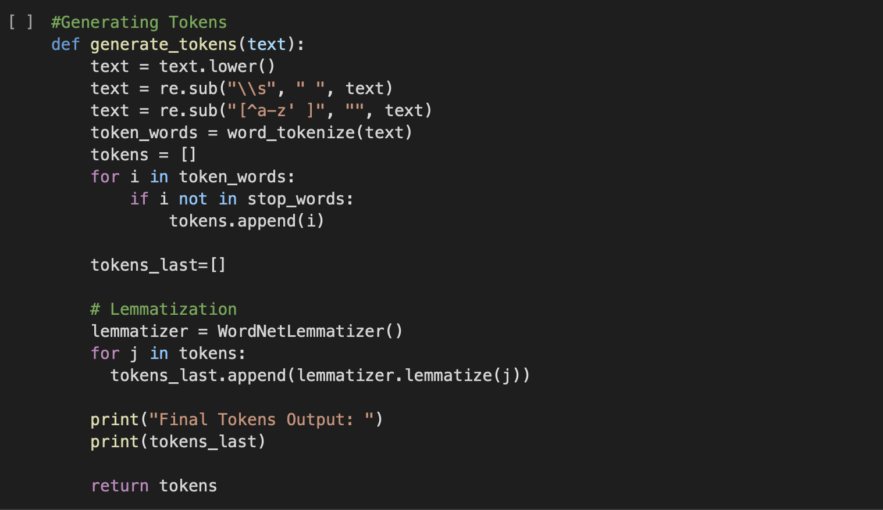
Lemmatization, Generating tokens:-
Lemmatization:- is the process where we take individual tokens from a sentence, and we try to reduce them to their base form.
A token is an instance of a sequence of characters that are grouped together as a useful semantic unit for processing.

Slide 6
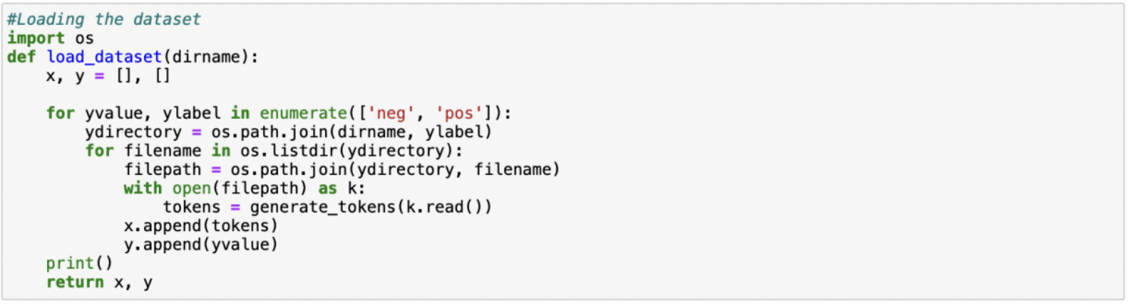
Loading the Dataset:-
Dataset :- http://ai.stanford.edu/~amaas/data/sentiment/aclImdb_v1.tar.gz

Slide 7
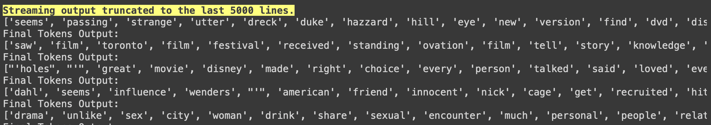
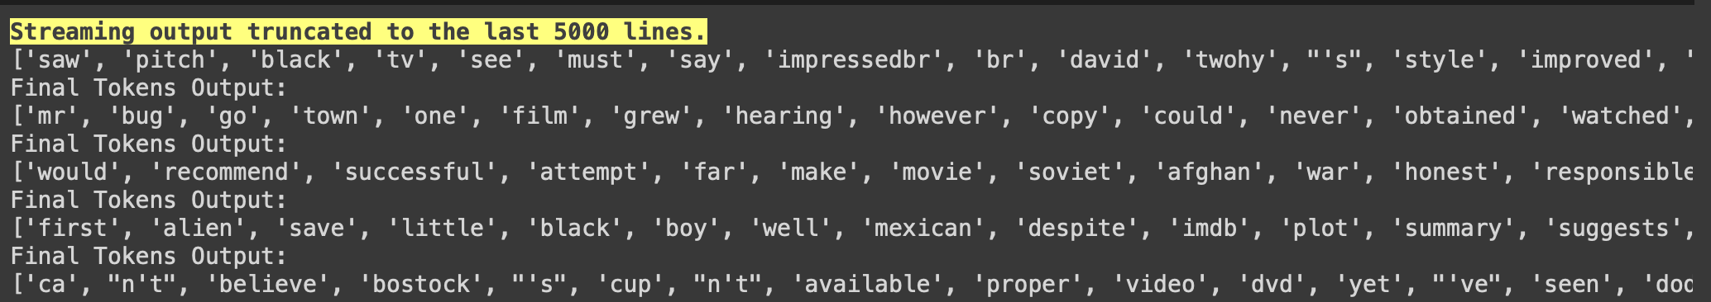
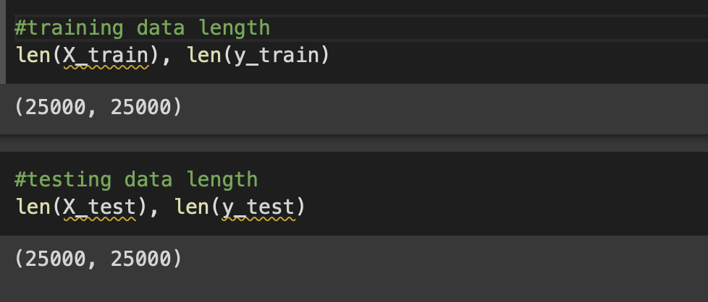

Slide 8
LSTM:- Long Short-Term Memory
Long Short-Term Memory (LSTM) networks are a type of recurrent neural network capable of learning order dependence in sequence prediction problems. This is a behavior required in complex problem domains like machine translation, speech recognition, and more.
Why LSTM?
- LSTM is a special kind of recurrent neural network capable of handling long-term dependencies.
For our project we used LSTM because it has more controlling knobs which controls the flow and mixing of inputs as compared to standard RNN . And since LSTM has more controlling knobs it brings more flexibility in controlling the output and gives us better results.

Slide 9
LSTM Over RNN
Let’s say while watching a video you remember the previous scene or while reading a book you know what happened in the earlier chapter. Similarly, RNNs work, they remember the previous information and use it for processing the current input. The shortcoming of RNN is, they can not remember Long term dependencies due to vanishing gradient. LSTMs are explicitly designed to avoid long-term dependency problems.
LSTM units include a 'memory cell' that can maintain information in memory for long periods of time

Slide 10
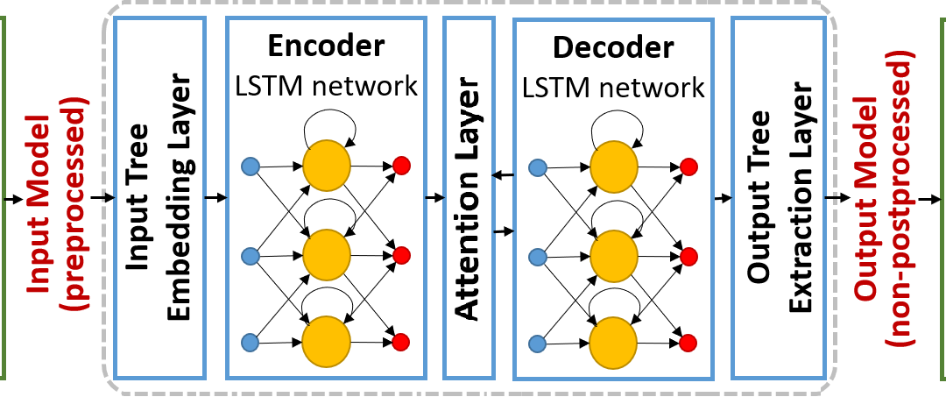
Architecture:-
The basic difference between the architectures of RNNs and LSTMs is that the hidden layer of LSTM is a gated unit or gated cell. It consists of four layers that interact with one another in a way to produce the output of that cell along with the cell state. These two things are then passed onto the next hidden layer. Unlike RNNs which have got the only single neural net layer of tanh, LSTMs comprises of three logistic sigmoid gates and one tanh layer. Gates have been introduced in order to limit the information that is passed through the cell. They determine which part of the information will be needed by the next cell and which part is to be discarded. The output is usually in the range of 0-1 where ‘0’ means ‘reject all’ and ‘1’ means ‘include all’.

Slide 11
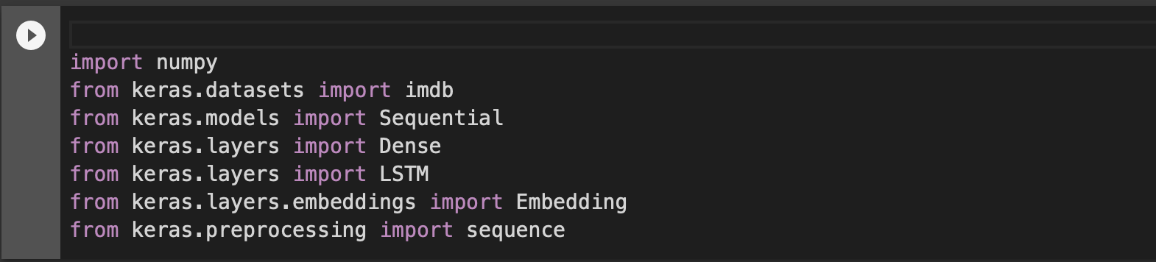
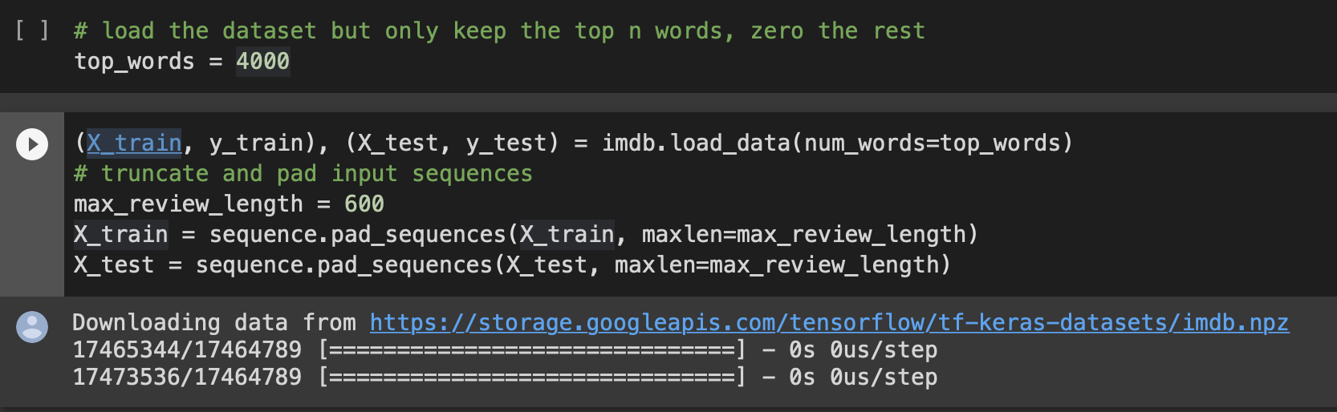
LSTM for sequence classification in the IMDB dataset:-
Importing the Libraries:-
To ensure that results are reproducible we keep random seed is 5.
Loading the dataset and keep top 4000 words and max review length is 600.

Slide 12
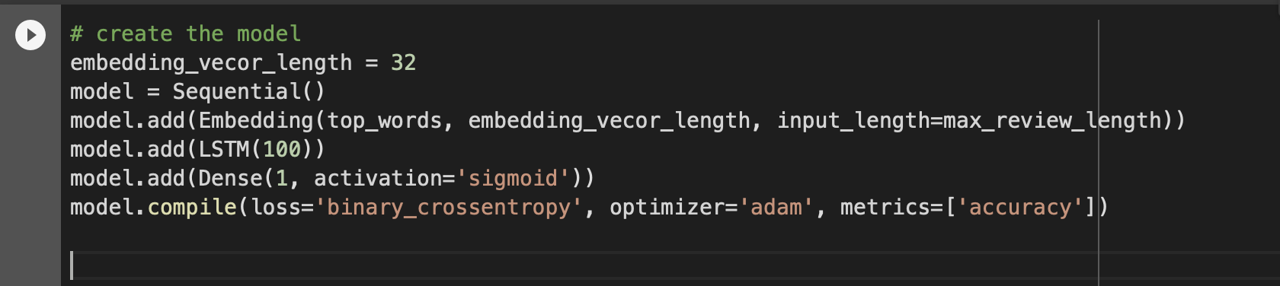
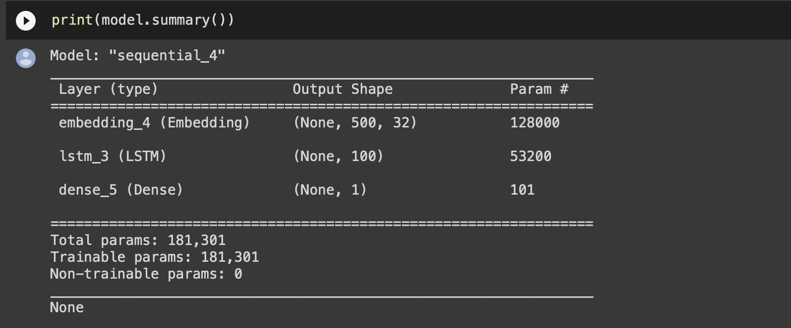
Creating the Model

Slide 13
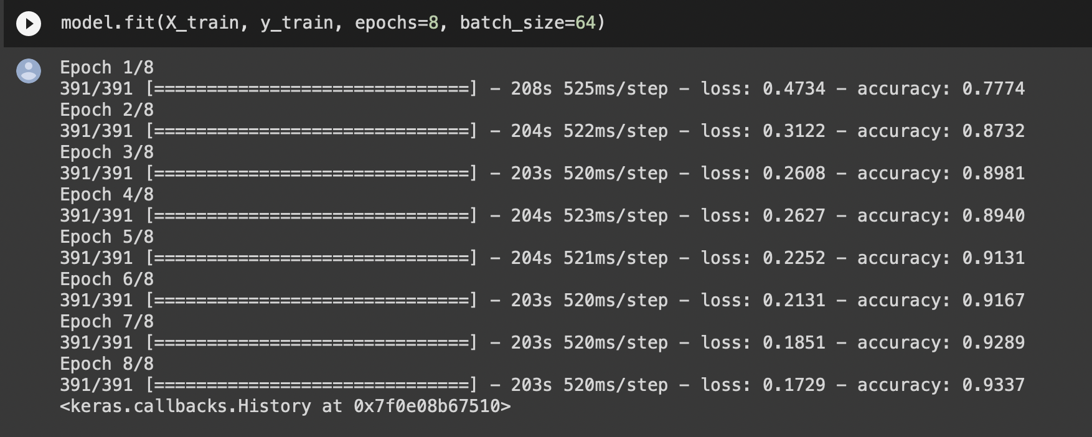
Epochs=8 , Number of passes of the entire training dataset the machine learning algorithm has completed. An epoch means training the neural network with all the training data for one cycle. In an epoch, we use all the data exactly once.

Slide 14
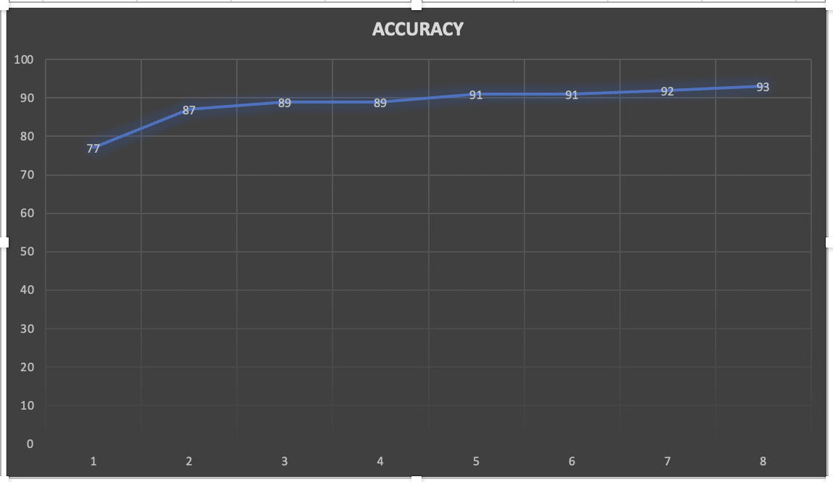
Accuracy Graph
”Loss" refers to the loss value over the training data after each epoch. This is what the optimization process is trying to minimize with the training so, the lower, the better.
”Accuracy" refers to the ratio between correct predictions and the total number of predictions in the training data. The higher, the better. This is normally inversely correlated with the loss.

Slide 15
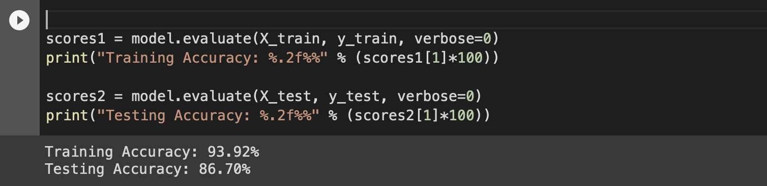
Final evaluation of the model with Accuracy
 | Accuracy
Training Accuracy | 93.92%
Testing Accuracy | 86.70%

Slide 16
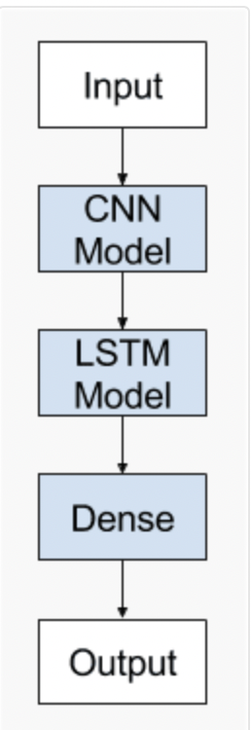
LSTM with CNN
DEFINITION: The CNN LSTM architecture involves using Convolution Neural Network (CNN) layers for feature extraction on input data combined with LSTMs to support sequence prediction.
Why did we choose LSTM with CNN?:
CNNs have the ability to use filters to compute dilations between each cells , For this reason , LSTM and CNN layer are often combined when forecasting a time series which allows the neural network to better understand the relationships between the different observations in the time series.
The CNN LSTM architecture involves using Convolutional Neural Network (CNN) layers for feature extraction on input data combined with LSTMs to support sequence prediction

Slide 17
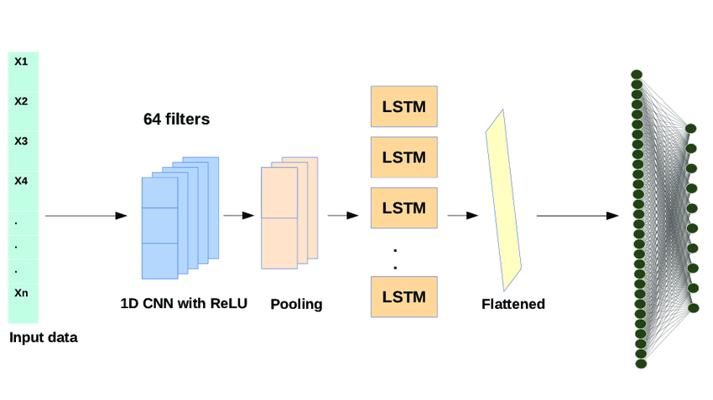
Implement CNN LSTM in Keras
We can define a CNN LSTM model to be trained jointly in Keras.
A CNN LSTM can be defined by adding CNN layers on the front end followed by LSTM layers with a Dense layer on the output.

Slide 18
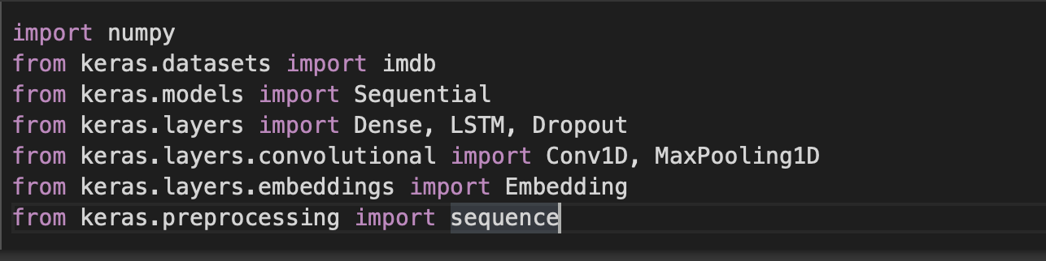
Importing the Libraries
from keras.datasets import imdb :- Loads the IMDB dataset
from keras.models import Sequential :- Sequential API is used to create models' layer-by-layer.
from keras.layers import Dense, LSTM, Dropout :- Dense layer is the regular deeply connected neural network layer
from keras.layers.convolutional import Conv1D, MaxPooling1D :- 1D convolution layer , Max pooling operation for 1D temporal data.
from keras.layers.embeddings import Embedding :- Embedding layer enables us to convert each word into a fixed length vector of defined size.
from keras.preprocessing import sequence :- This function transforms a list (of length num_samples ) of sequences (lists of integers) into a 2D Numpy array of shape (num_samples, num_timesteps).

Slide 19
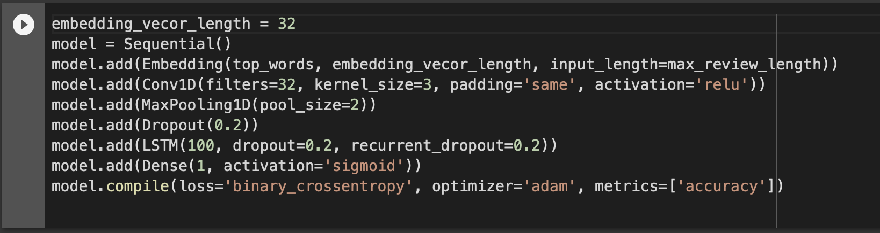
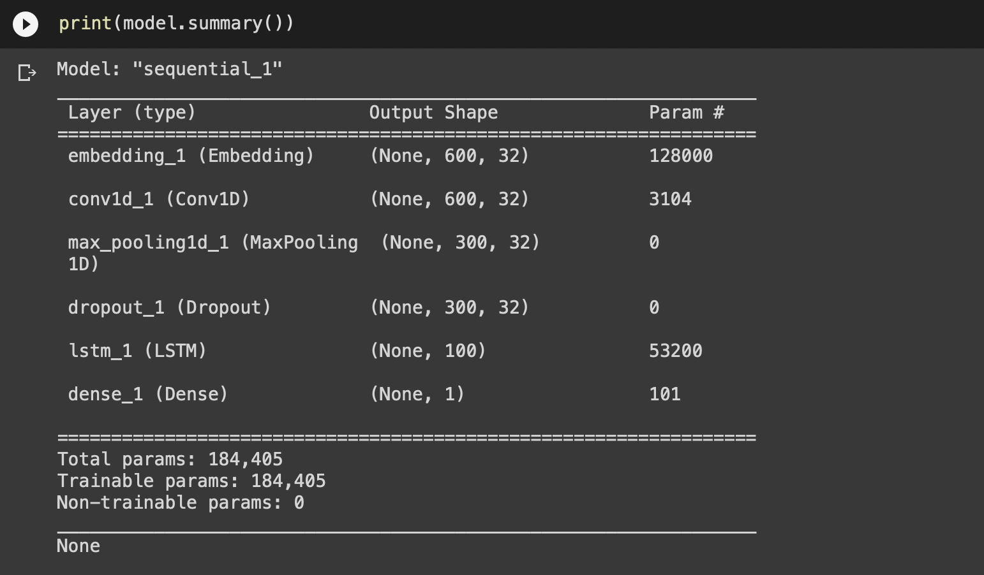
Creating the Model
1D CNN model with layers like the one below.
Activation=‘relu’ :- The activation function is responsible for transforming the summed weighted input from the node into the activation of the node or output for that input.
Activation=‘sigmoid’:- It guarantee that the output of this unit will always be between 0 and 1

Slide 20
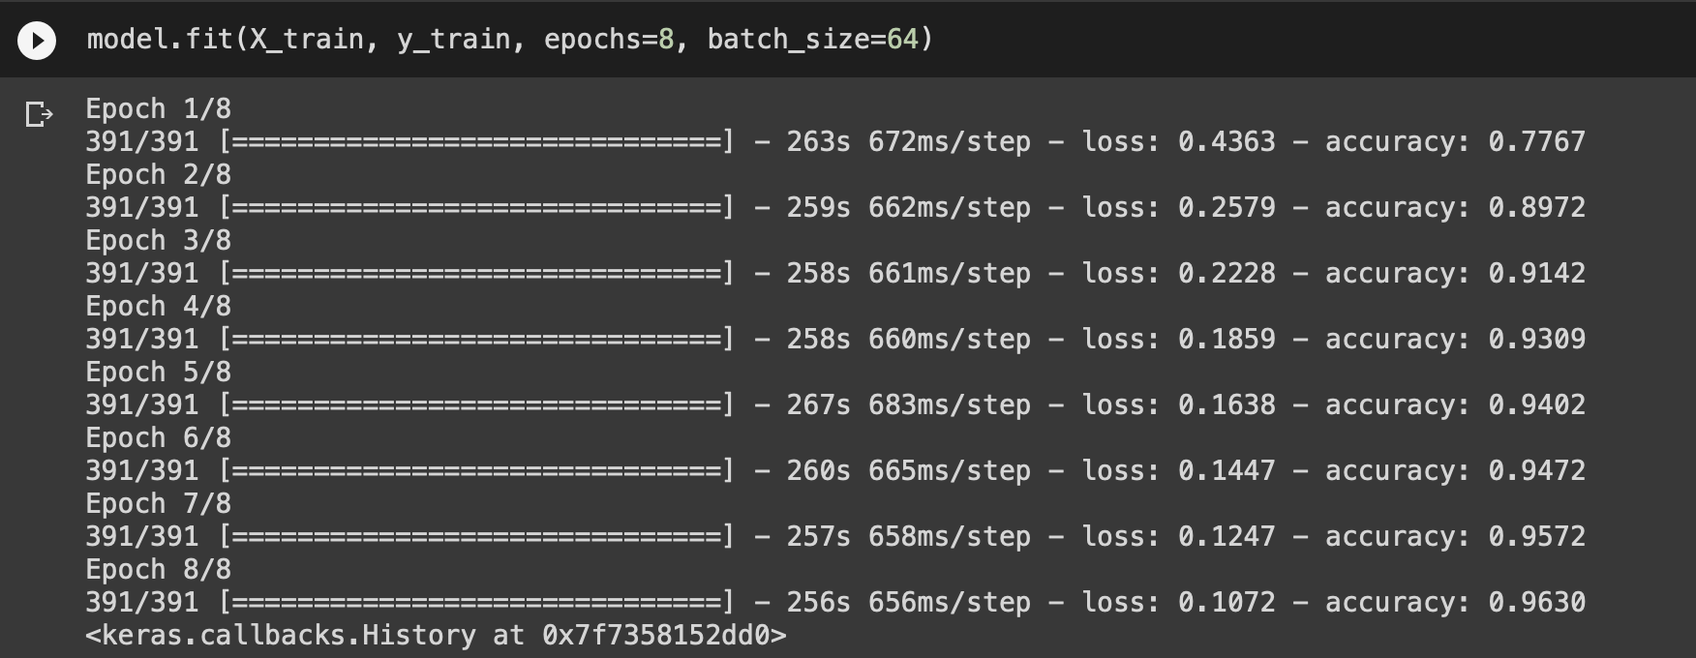
one pass over the entire dataset:-
Epochs=8 , Number of passes of the entire training dataset the machine learning algorithm has completed.

Slide 21
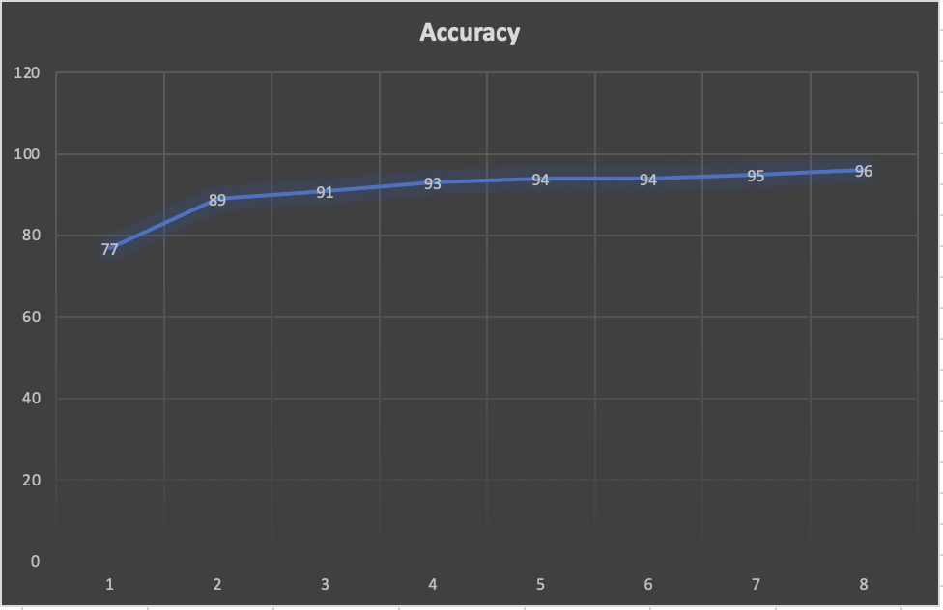
Accuracy Graph Accuracy is the number of correct classifications / the total amount of classifications

Slide 22
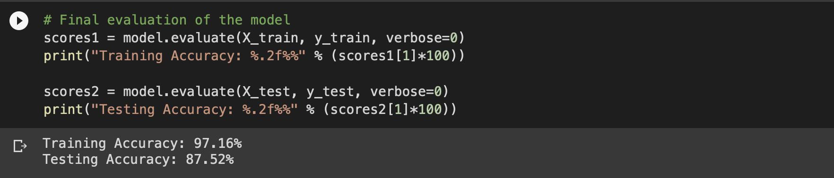
Final evaluation of the model with Accuracy
 | Accuracy
Training Accuracy | 97.16%
Testing Accuracy | 87.52%

Slide 23
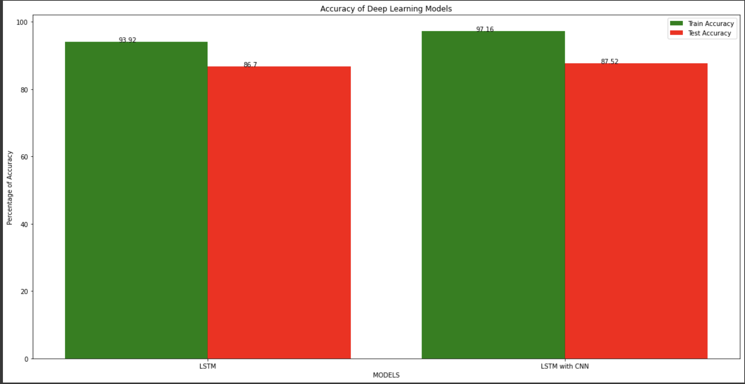
Comparison:-
The basic difference between the architectures of RNNs and LSTMs is that the hidden layer of LSTM is a gated unit or gated cell. It consists of four layers that interact with one another in a way to produce the output of that cell along with the cell state. These two things are then passed onto the next hidden layer. Unlike RNNs which have got the only single neural net layer of tanh, LSTMs comprises of three logistic sigmoid gates and one tanh layer. Gates have been introduced in order to limit the information that is passed through the cell. They determine which part of the information will be needed by the next cell and which part is to be discarded. The output is usually in the range of 0-1 where ‘0’ means ‘reject all’ and ‘1’ means ‘include all’.

Slide 24
GRU-Grated recurrent unit
DEFINITION: It is a gating mechanism in recurrent neural network .
GRU is like a long-short term memory with a forget gate but has fewer parameters than LSTM .
It does not have an output gate , but has update gate and reset gate
Why did we choose GRU?
Since GRU has update and reset gates by using these two vectors ,the model gives output by controlling the flow of information
GRU is a memory centered type of neural network .Other Neural Network does not have the ability to retain information
GRU is used when you have less memory consumption and wants faster result

Slide 25
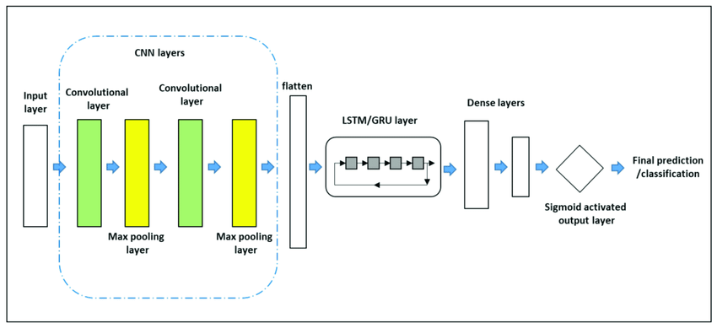
Gated Recurrent Units are recent form of recurrent neural network which can store information of long-term dependencies in sequential data. In this work we showed that GRU are suitable for processing long textual data and applied it to the task of sentiment analysis.
CNN is not able to memorize the context of conversation which is not suitable for real-time usage. So as a solution to this Gated Recurrent Unit (GRU) was represented. It has a memory cell unit to remember the context of previous sequences.
The GRU comprises of the reset gate and the update gate instead of the input, output and forget gate of the LSTM.

Slide 26
What is the purpose of dense layer?
Dense Layer is simple layer of neurons in which each neuron receives input from all the neurons of previous layer, thus called as dense. Dense Layer is used to classify image based on output from convolutional layers.
ReLU for short is a piecewise linear function that will output the input directly if it is positive, otherwise, it will output zero.
When the activation function for a neuron is a sigmoid function, it is a guarantee that the output of this unit will always be between 0 and 1.
In terms of model training speed, GRU is 29.29% faster than LSTM for processing the same dataset

Slide 27
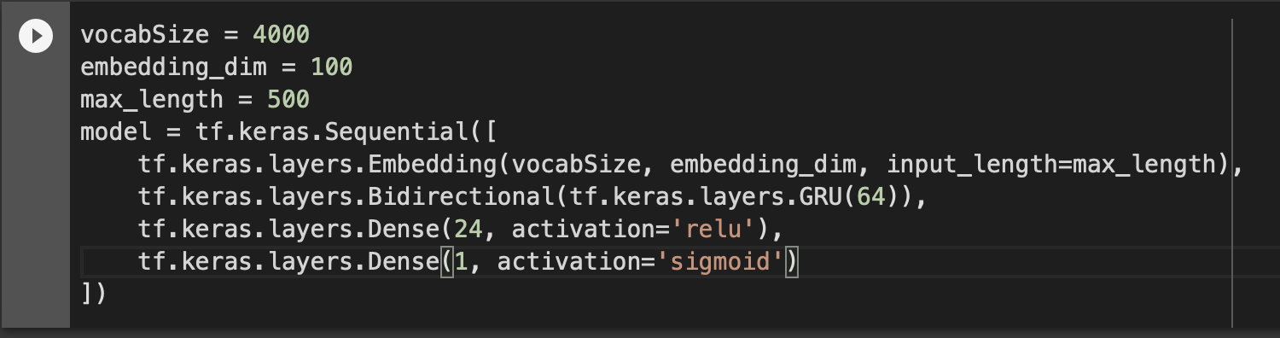
Creating and Compiling the Model
A metric is a function that is used to judge the performance of your model. Metric functions are like loss functions, except that the results from evaluating a metric are not used when training the model.

Slide 28
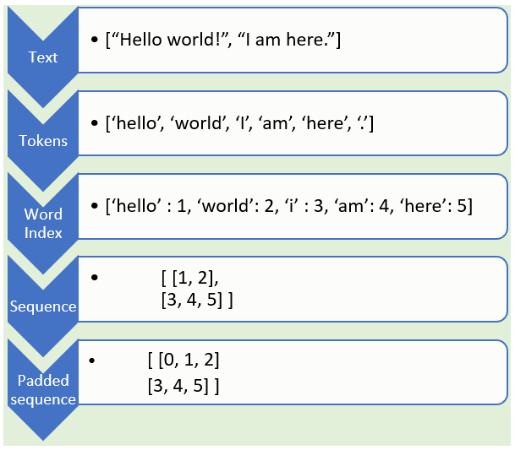
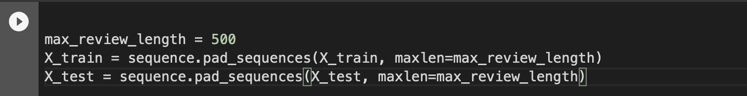
Truncate and pad Input sequences
pad_sequences is used to ensure that all sequences in a list have the same length. By default, this is done by padding 0 in the beginning of each sequence until each sequence has the same length as the longest sequence.

Slide 29
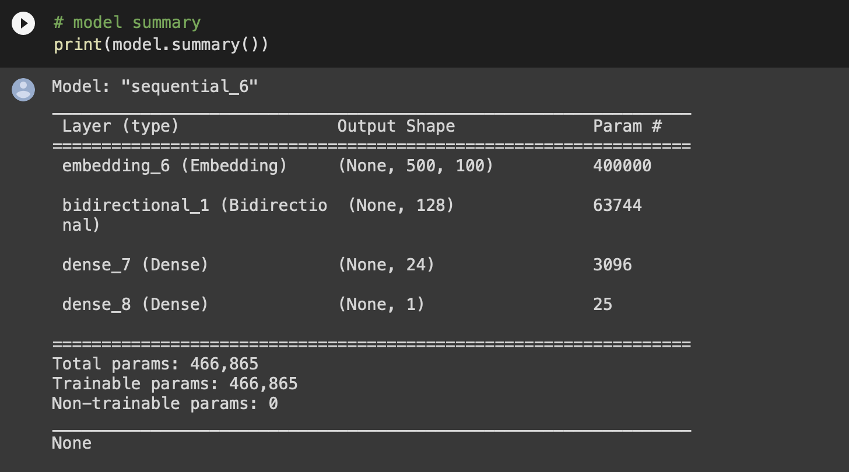
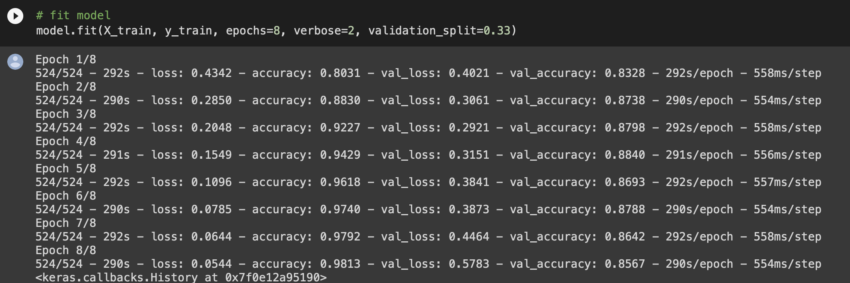
verbose=2 :- Mention the number of epoch like this.
It is the parameter specifying how big chunk of training data will be used for validation. It’s a float value between 0 and 1. Validation data is not used for the training, but to evaluate the loss and the accuracy.
validation_split=0.33 will cause that 33% of the training data will be used for validation.

Slide 30
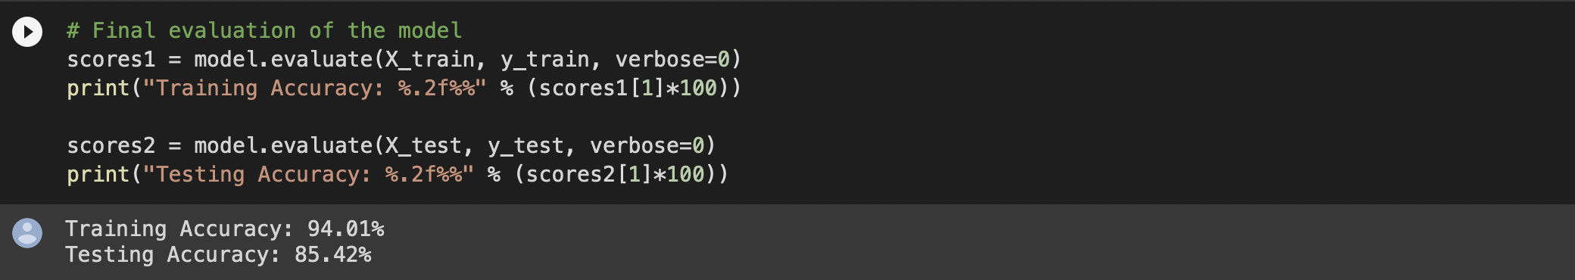
Final evaluation of the model with Accuracy
 | Accuracy
Training Accuracy | 94.10%
Testing Accuracy | 85.42%

Slide 31
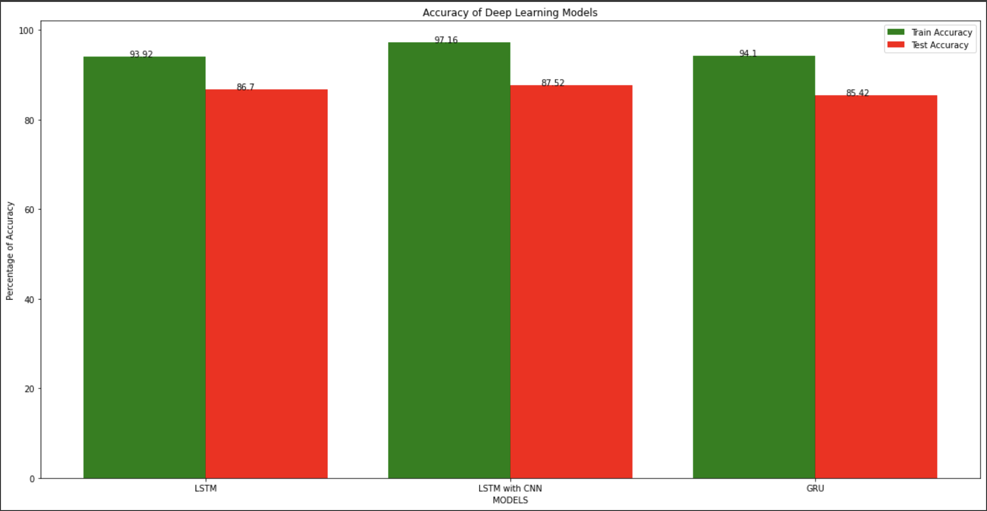
Comparison:-
Gated Recurrent Units, In simple words, the GRU unit does not have to use a memory unit to control the flow of information like the LSTM unit. It can directly make use of the all-hidden states without any control. GRUs have fewer parameters and thus may train a bit faster or need less data to generalize. But, with large data, the LSTMs with higher expressiveness may lead to better results.
They are almost similar to LSTMs except that they have two gates: reset gate and update gate. Reset gate determines how to combine new input to previous memory and update gate determines how much of the previous state to keep. Update gate in GRU is what input gate and forget gate were in LSTM. We don't have the second nonlinearity in GRU before calculating the output, neither they have the output gate.
Choose LSTM if you are dealing with large sequences and accuracy is concerned, GRU is used when you have less memory consumption and want faster results.

Slide 32
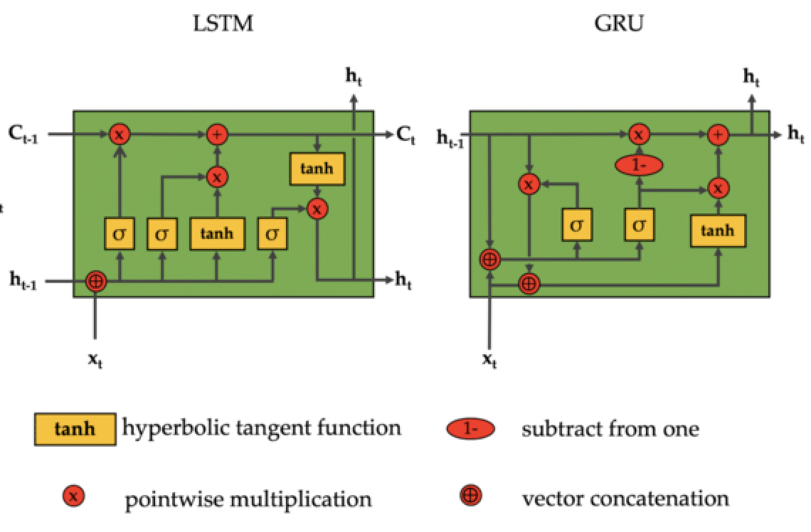
Comparison:-
In terms of model training speed, GRU is 29.29% faster than LSTM for processing the same dataset; and in terms of performance, GRU performance will surpass LSTM in the scenario of long text and small dataset, and inferior to LSTM in other scenarios.
GRU is less complex than LSTM because it has a smaller number of gates (The key difference between GRU and LSTM is that GRU's bag has two gates that are reset and update while LSTM has three gates that are input, output, forget.). If the dataset is small, then GRU is preferred otherwise LSTM for the larger dataset.

Slide 33
What Next?
We are Implementing GloVe Encoding on same dataset.
GloVe is an unsupervised learning algorithm for obtaining vector representations for words. Training is performed on aggregated global word-word co-occurrence statistics from a corpus, and the resulting representations showcase interesting linear substructures of the word vector space.
How does GloVe embed work?
The basic idea behind the GloVe word embedding is to derive the relationship between the words from statistics. Unlike the occurrence matrix, the co-occurrence matrix tells you how often a particular word pair occurs together. Each value in the co-occurrence matrix represents a pair of words occurring together.

Slide 34
Glove Encoding
GloVe stands for global vectors for word representation. It is an unsupervised learning algorithm.
Word embeddings are basically a form of word representation that bridges the human understanding of language to that of a machine.
The basic idea behind the GloVe word embedding is to derive the relationship between the words from statistics. Unlike the occurrence matrix, the co-occurrence matrix tells you how often a particular word pair occurs together. Each value in the co-occurrence matrix represents a pair of words occurring together.

Slide 35
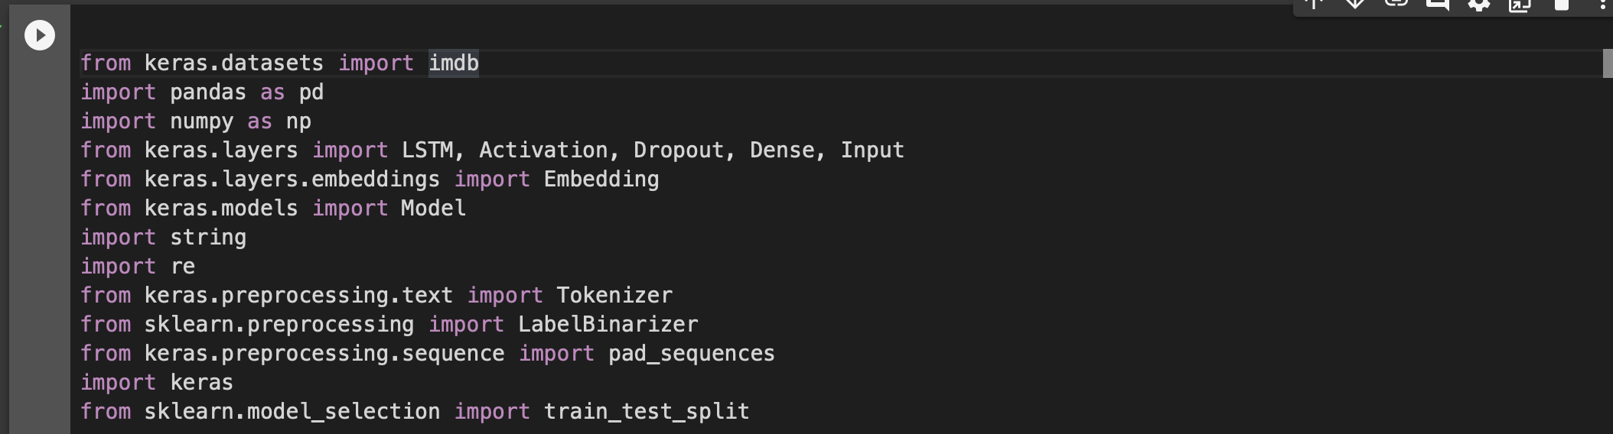
Libraries Used for Glove Model
Dense layer is the regular deeply connected neural network layer. It is most common and frequently used layer.
The function of the dropout layer is just to add noise so the model learns to generalize better.
At learning time, this simply consists in learning one regressor or binary classifier per class. In doing so, one needs to convert multi-class labels to binary labels (belong or does not belong to the class). LabelBinarizer makes this process easy with the transform method.
The Tokenizer class of Keras is used for vectorizing a text corpus.

Slide 36
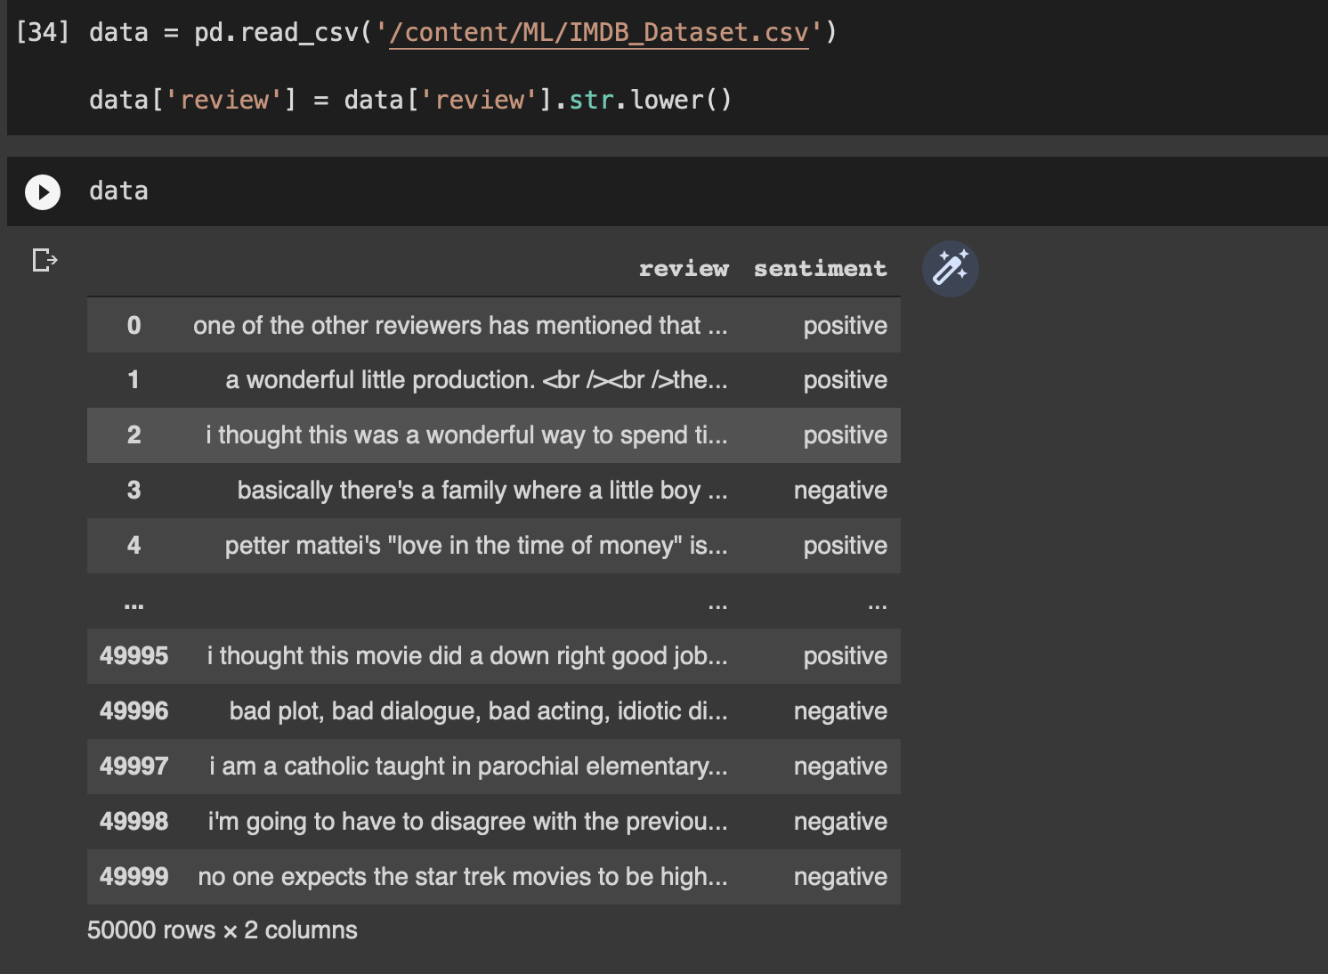
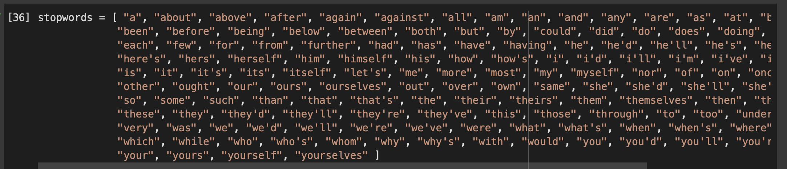
Dataset and Stopwords

Slide 37
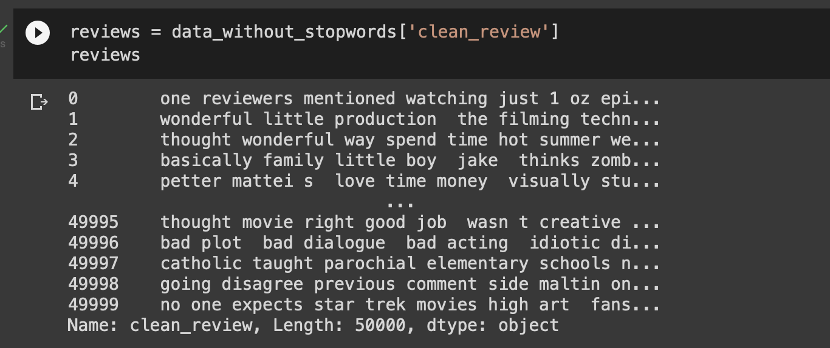
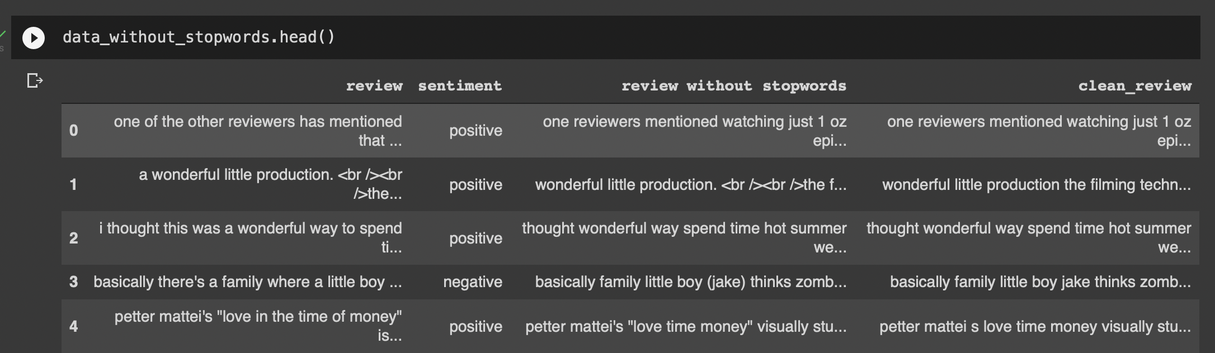
Representation of Dataset with Stop words
The words which are generally filtered out before processing a natural language are called stop words.

Slide 38
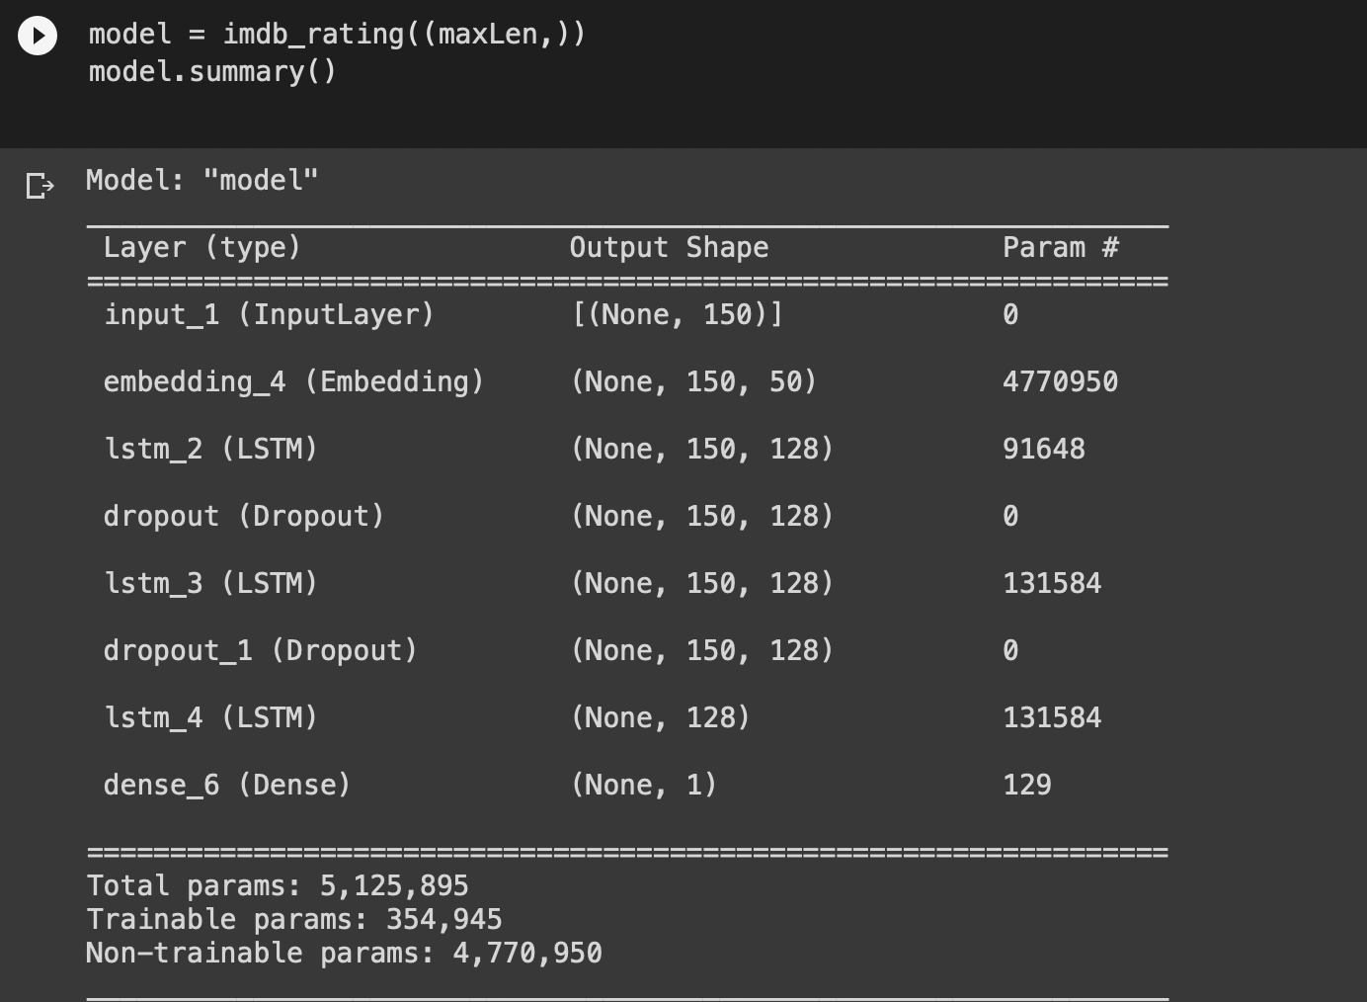
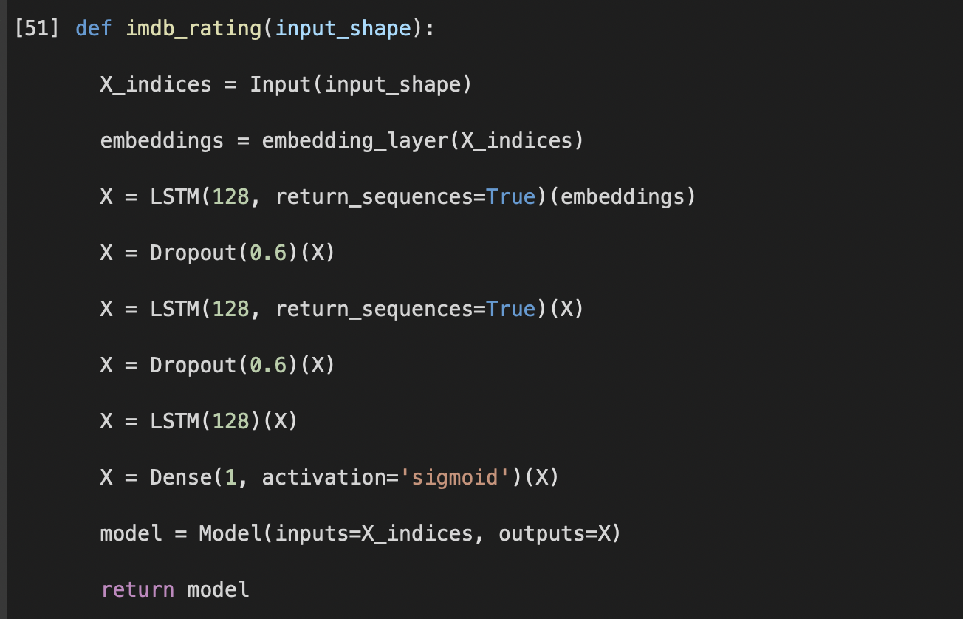
Model Architecture and Summary.
This function defines our model architecture, first, we use the embedding layer to map the words to their GloVe vectors, and then those vectors are input to the LSTM layers followed by a Dense layer with ‘sigmoid’ activation.

Slide 39
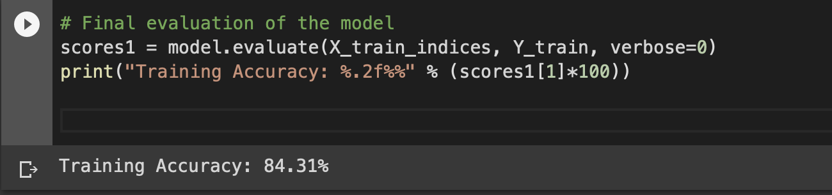
Final evaluation
After evaluating the model on the test set, I got an accuracy of 85.86% which is pretty good and there is no problem of overfitting.

Slide 40
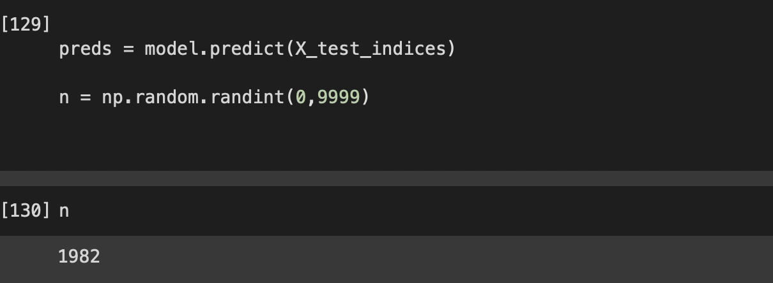
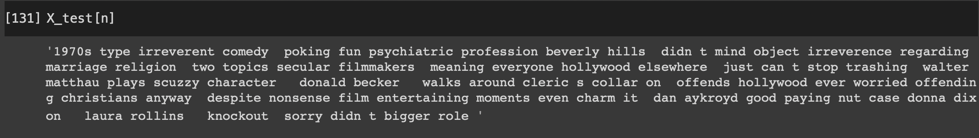
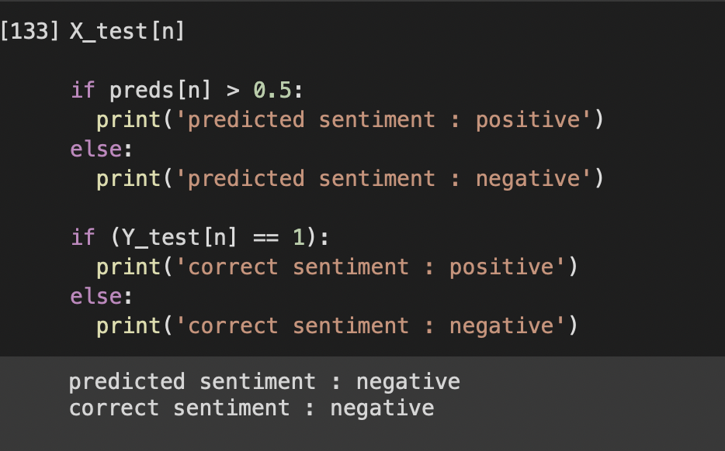
Prediction of Model

Slide 41
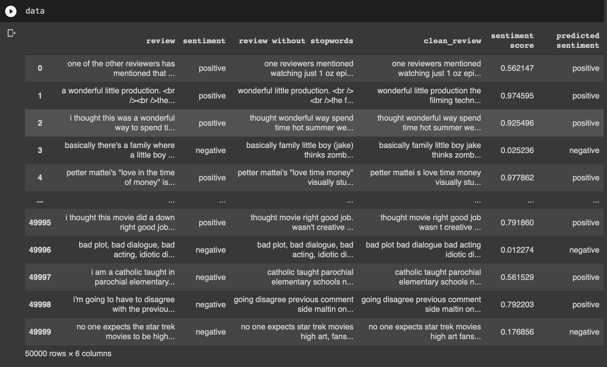
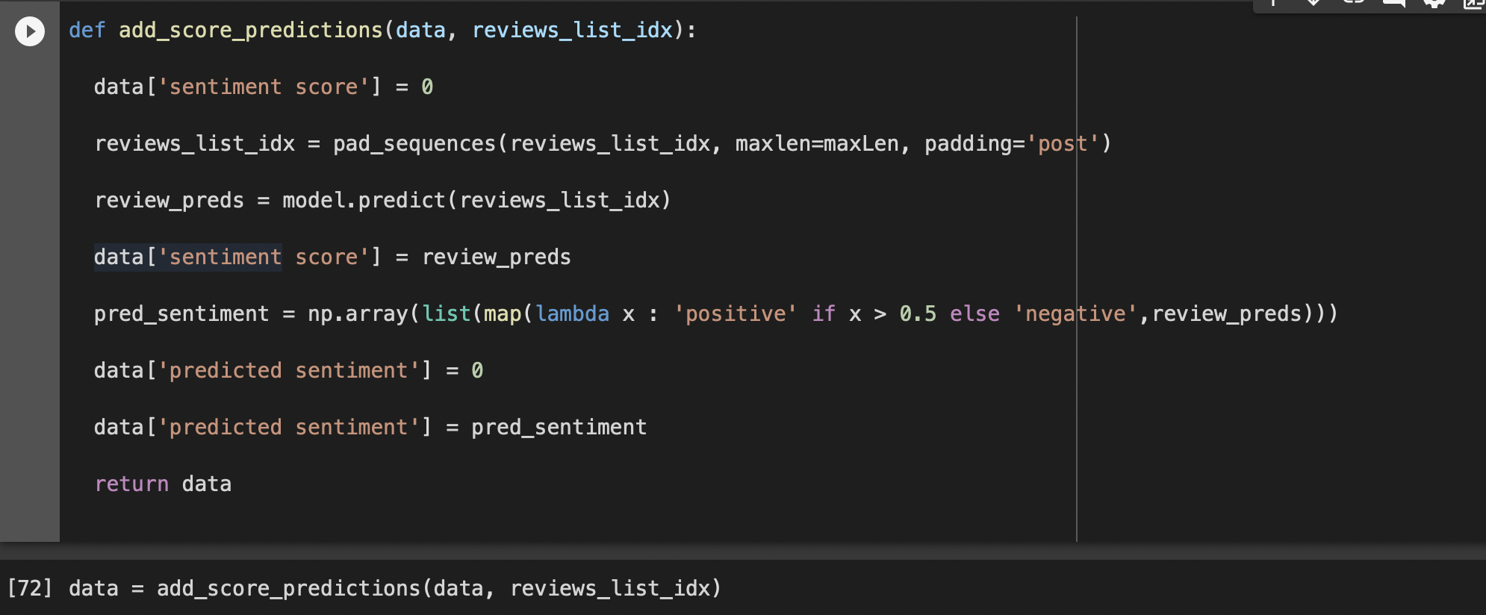
Modified Dataset
This function returns us a modified data frame which looks like.

Slide 42
Conclusion:
The advantage of GloVe is that, unlike Word2vec, GloVe does not rely just on local statistics (local context information of words) but incorporates global statistics (word co-occurrence) to obtain word vectors.

Slide 43

References:-
https://ieeexplore.ieee.org/stamp/stamp.jsp?arnumber=9257657
https://nlp.stanford.edu/~socherr/EMNLP2013_RNTN.pdf
https://www.kaggle.com/code/ngyptr/lstm-sentiment-analysis-keras/notebook
https://towardsdatascience.com/sentiment-analysis-using-lstm-step-by-step-50d074f09948
https://towardsdatascience.com/sentiment-analysis-using-lstm-and-glove-embeddings-99223a87fe8e
https://medium.com/aubergine-solutions/scratching-surface-of-rnn-gru-and-lstm-with-example-of-sentiment-analysis-8dd4e748d426
https://haochen23.github.io/2020/01/nlp-rnn-sentiment.html#.YkcEVC1h1QI

Slide 44


